Slide 1
dbms
Module 3 part 1

Slide 2
index
SQL queries on single and multiple tables
Nested queries (correlated and non-correlated)
Aggregation
Grouping
Views

Slide 3
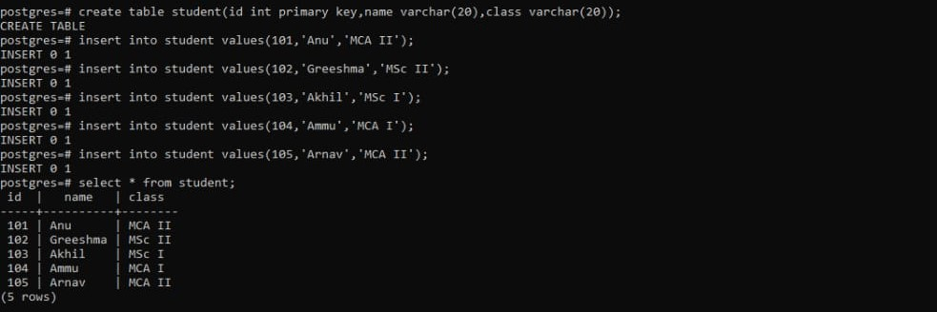
SQL queries on single and multiple tables
Create a Table named 'Student' with fileds - 'ID', 'Name' and 'Class'.
Add the necessary 'Keys' and 'Restrictions'.
Insert 5 (Five) set of values into the table.

Slide 4
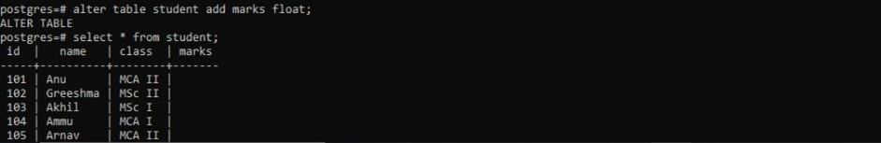
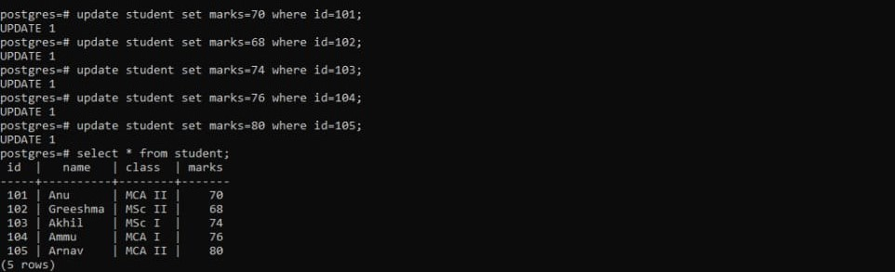
Add a new Column named 'Marks'.
Update Marks's value for each entry

Slide 5
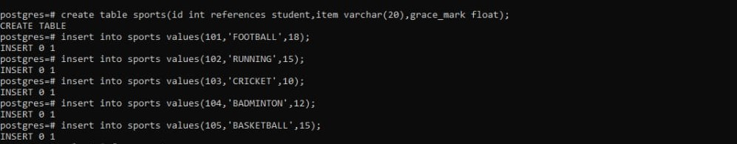
Create a Table named 'Sports' with fields - 'ID', 'Item' and 'Grace_mark'.
• Add the necessary 'Keys' and 'Restrictions' - 'ID' must refer 'Student' table 'ID'.
• Insert 5 (Five) Entries to the table 'Sports'.

Slide 6
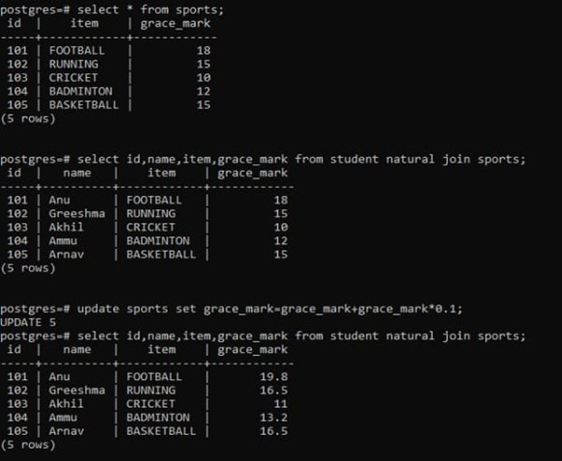
Select and display 'ID', 'Name', 'Item', 'Grace_mark' of all students.
• Give each student an update in 'Grace_mark' by '10%' (Ten Percentage).

Slide 7
Nested queries
A Nested query or sub query or inner query is a query within another SQL query and embedded within the WHERE clause
It is used to return data that will be used in the main query as a condition to further restrict the data to be retrieved
Subqueries can be used with the SELECT, INSERT, UPDATE, and DELETE statements along with the operators like =, <, >, >=, <=, IN, BETWEEN, etc.
It must be enclosed within paranthesis

Slide 8
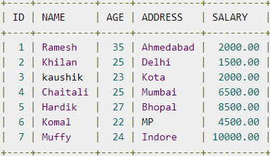
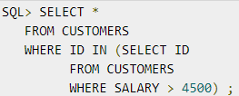
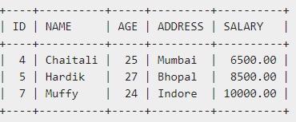

Slide 9
Noncorrelated Subqueries
A noncorrelated (simple) subquery obtains its results independently of its containing (outer) statement.
The subquery executes first, and then passes its results to the outer query
Eg:
SELECT name, street, city, state FROM addresses WHERE state IN (SELECT state FROM states);

Slide 10
Correlated Subqueries
A correlated subquery typically obtains values from its outer query before it executes. When the subquery returns, it passes its results to the outer query.
Eg:
SELECT name, street, city, state FROM addresses WHERE EXISTS (SELECT * FROM states WHERE states.state = addresses.state);

Slide 11
Aggregate Functions
Aggregate functions are functions that take a collection (a set or multiset) of values as input and return a single value
All the aggregate functions are used in Select statement.
Average: avg
Minimum: min
Maximum: max
Total: sum
Count: count

Slide 12
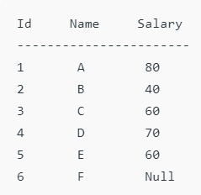
1.Count(*): Returns total number of records .i.e 6.
Count(salary): Return number of Non Null values over the column salary. i.e 5.
Count(Distinct Salary): Return number of distinct Non Null values over the column salary .i.e 4
2.sum(salary): Sum all Non Null values of Column salary i.e., 310
sum(Distinct salary): Sum of all distinct Non-Null values i.e., 250.

Slide 13
3.Avg(salary) = Sum(salary) / count(salary) = 310/5
Avg(Distinct salary) = sum(Distinct salary) / Count(Distinct Salary) = 250/4
4.Min(salary): Minimum value in the salary column except NULL i.e., 40.
5.Max(salary): Maximum value in the salary i.e., 80.

Slide 14
Group by
The GROUP BY Statement in SQL is used to arrange identical data into groups with the help of some functions.
i.e if a particular column has same values in different rows then it will arrange these rows in a group.
GROUP BY clause is used with the SELECT statement.
In the query, GROUP BY clause is placed after the WHERE clause.

Slide 15
Syntax:
SELECT column1, function_name(column2)
FROM table_name
WHERE condition
GROUP BY column1, column2
ORDER BY column1, column2;

Slide 16
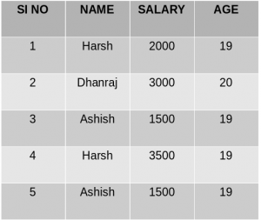
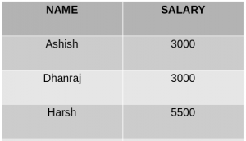
Group By single column: Group By single column means, to place all the rows with same value of only that particular column in one group.
SELECT NAME, SUM(SALARY) FROM Employee GROUP BY NAME;
Group By single column: Group By single column means, to place all the rows with same value of only that particular column in one group.
SELECT NAME, SUM(SALARY) FROM Employee GROUP BY NAME;

Slide 17
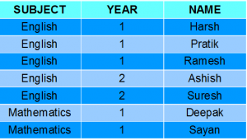

Group By multiple columns: Group by multiple column is say for example, GROUP BY column1, column2. This means to place all the rows with same values of both the columns column1 and column2 in one group.
SELECT SUBJECT, YEAR, Count(*) FROM Student GROUP BY SUBJECT, YEAR;

Slide 18
views
Views in SQL are kind of virtual tables.
It is a single table derived from other tables
A view also has rows and columns as they are in a real table in the database.
We can create a view by selecting fields from one or more tables present in the database.
A View can either have all the rows of a table or specific rows based on certain condition.

Slide 19
Syntax:
CREATE VIEW view_name AS
SELECT column1, column2.....
FROM table_name
WHERE condition;

Slide 20
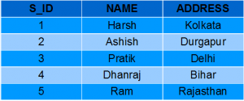
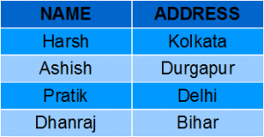
Creating View from a single table:
CREATE VIEW DetailsView AS
SELECT NAME, ADDRESS
FROM StudentDetails
WHERE S_ID < 5;
SELECT * FROM DetailsView;

Slide 21
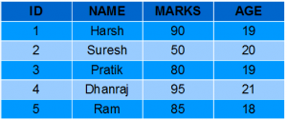
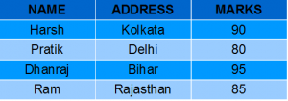
Creating View from multiple tables:
CREATE VIEW MarksView AS
SELECT StudentDetails.NAME, StudentDetails.ADDRESS, StudentMarks.MARKS
FROM StudentDetails, StudentMarks
WHERE StudentDetails.NAME = StudentMarks.NAME;
SELECT * FROM MarksView;

Slide 22
THANK YOU

Slide 23
dbms
Module 3 part 2

Slide 24
index
Assertions
Triggers
SQL data types.

Slide 25
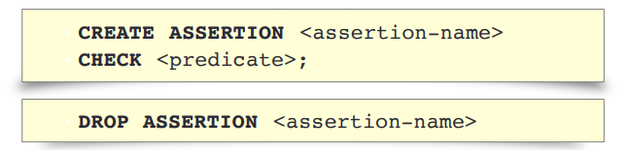
Assertions
An assertion is a predicate expressing a condition that we wish the database always to satisfy
It is used to check something that should never happen
Syndax
Not all DB system support assertion

Slide 26
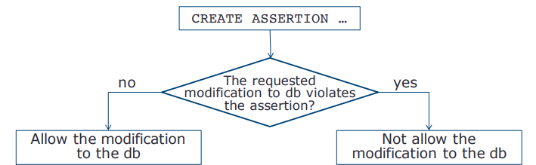
WORKING

Slide 27
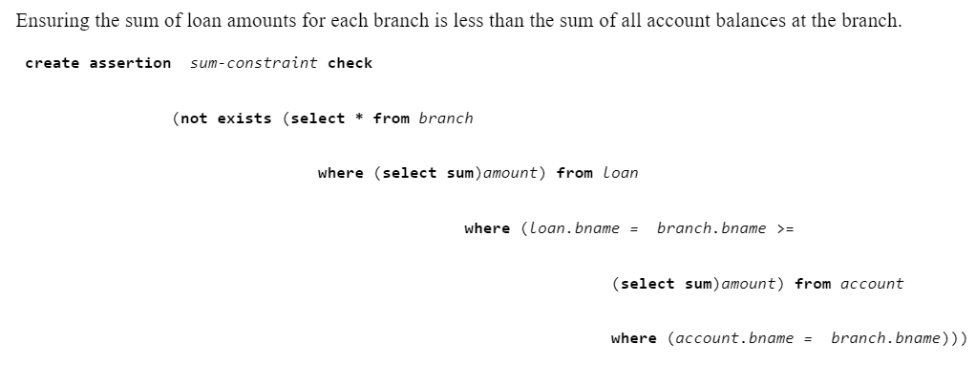
Eg:

Slide 28
triggers
A trigger is a stored procedure in database which automatically invokes whenever a special event in the database occurs.
For example, a trigger can be invoked when a row is inserted into a specified table or when certain table columns are being updated.

Slide 29
Syntax:
create trigger [trigger_name]
[before | after]
{insert | update | delete}
on [table_name]
[for each row]
[trigger_body]

Slide 30
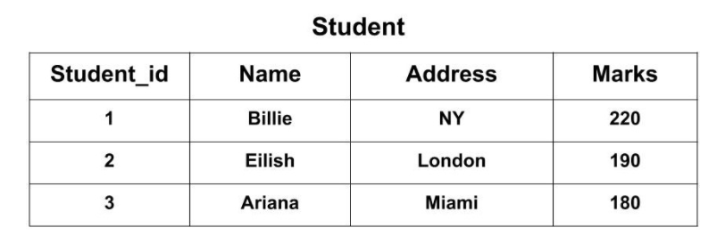
Eg:
CREATE TRIGGER Add_marks BEFORE INSERT ON Student FOR EACH ROW SET new.Marks = new.Marks + 100;

Slide 31
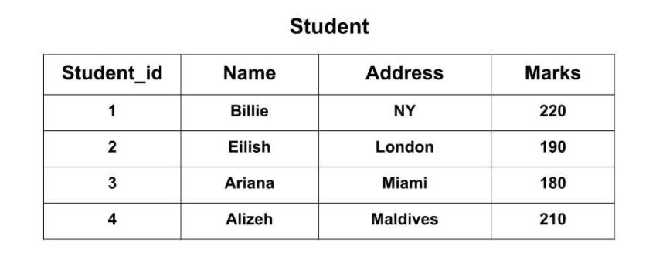
INSERT INTO Student(Name, Address, Marks) VALUES('Alizeh', 'Maldives', 110);
SELECT * FROM Student;

Slide 32
SQL DATATYPES
SQL Datatype is used to define the values that a column can contain.
Every column is required to have a name and data type in the database table.
Types:
Numeric data types include integer numbers of various sizes (INTEGER or INT, and SMALLINT) and floating-point (real) numbers of various precision (FLOAT or REAL, and DOUBLE PRECISION).

Slide 33
Character-string data types are either fixed length—CHAR(n),where n is the number of characters—or varying length— VARCHAR(n), where n is the maximum number of characters
Bit-string data types are either of fixed length n—BIT(n)—or varying length— BIT VARYING(n), where n is the maximum number of bits
Another variable-length bitstring data types called BINARY LARGE OBJECT (BLOB) and CHARACTER LARGE OBJECT(CLOB)
EG: book review clob(10KB)
image blob(10MB)
movie blob(2GB)

Slide 34
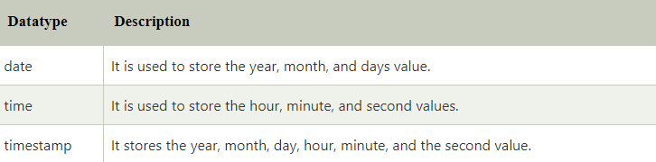
4. Date and Time Types
date ’2001-04-25’
time ’09:30:00’
timestamp ’2001-04-25 10:29:01.45’

Slide 35
User-Defined Types
A user-defined data type (UDT) is a data type that derived from an existing data type
Distinct types
Distinct types allow the creation of
user-defined data types that cannot
be compared.
create type Dollars as numeric(12,2) final;
create type Pounds as numeric(12,2) final;
create table department
(dept name varchar (20),
building varchar (15),
budget Dollars);

Slide 36
2. Structured type
It is a user-defined data type containing one or more named attributes, each of which has a data type
Eg:
1. Create Type 'Name' with 'first_name' and 'Last_name' - use appropriate data types.
2. Create Type 'Address' with 'Street', 'City', and 'PIN code' - use appropriate data types.
3. Create a table 'Person' with 'Name', 'Address', and Dob - use the above-created types and other appropriate data types.
4. Insert 10 Records to the 'Person' Table.

Slide 37
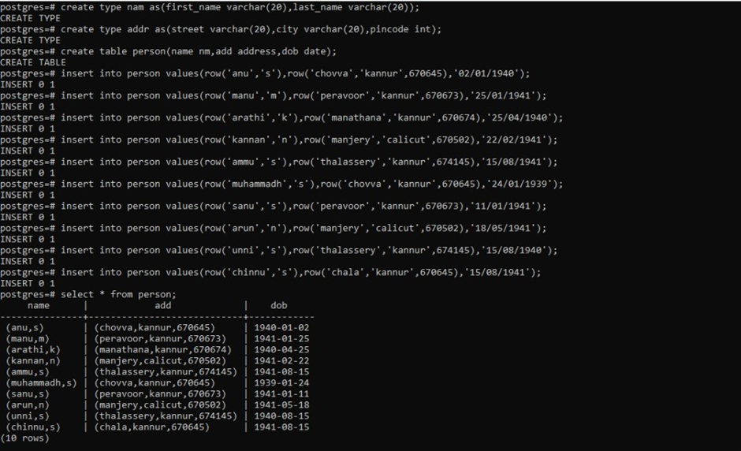

Slide 38
THANK YOU

Slide 39
dbms
Module 3 part 3

Slide 40
index
Physical Data Organization
Physical and logical records
Blocking factor
Pinned and unpinned organization
Heap files

Slide 41
Physical data organization
Databases are stored physically on storage devices and organized as files and records.
The overall performance of a database system is determined by the physical database organization.
Therefore, it is important that the physical organization of data is efficiently managed.

Slide 42
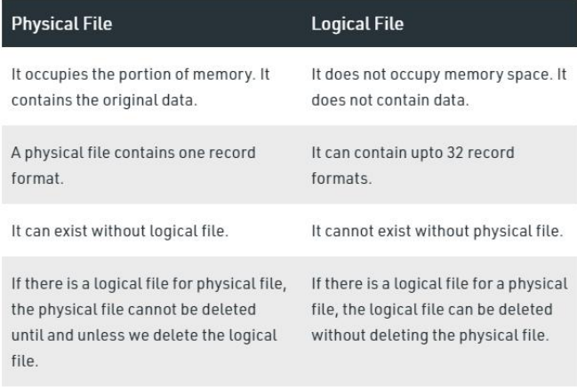

Slide 43
blocking factor
Blocking factor is the number of records in a block at a particular time.
If the files are numbered 0,1,2,3,….,r-1 and records in the blocks are numbered as 0,1,2,….bfr-1, where bfr is the blocking factor,
then the location of the ith record of a file can be determined by : [i/bfr] and it would be (i mod bfr)th record in the block

Slide 44
pinned and unpinned organization
A pin-count is the number of times that page has been requested, or the number of current users of that page.
If this count falls to zero, the page is considered unpinned.
Initially the pin-count for every page is set to zero
Incrementing the pin-count is called pinning.
When the request of the requester is fulfilled, the pin - count variable is decrement of that frame and releases the page. This is called unpinning the page.

Slide 45
Heap files
The heap file is also known as an unordered file.
Heap file organization is the simplest and most basic type of organization.
It works with data blocks.
In heap file organization, the records are inserted at the file's end. When the records are inserted, it doesn't require the sorting and ordering of records.
When the data block is full, the new record is stored in some other block. This new data block need not to be the very next data block, but it can select any data block in the memory to store new records.

Slide 46
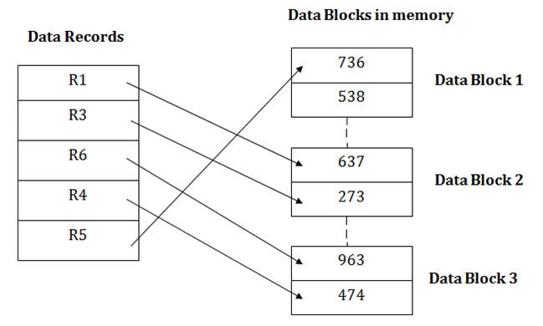

Slide 47
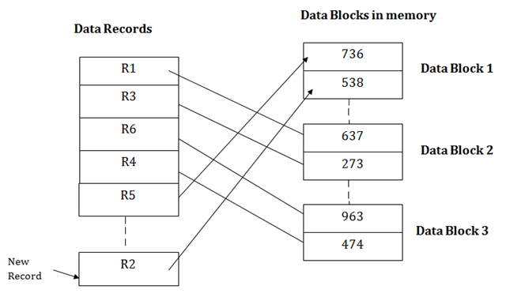

Slide 48
THANK YOU

